Slide 1
TalkingData AdTracking Fraud Detection
IP
APP
DEVICE
OS
CHANNEL
Can you detect fraudulent click traffic for mobile app ads?
Let’s predict if the click will convert to an actual download of the app.

Slide 2
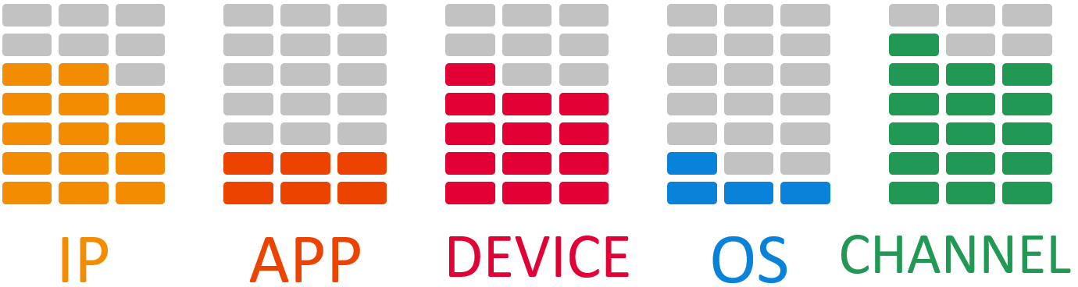
TalkingData AdTracking Fraud Detection
Factors associated with the risk of Click Fraud:
Resulting in misleading click data
Wasted money
Ad channels can drive up costs by simply clicking on the ad at a large scale

Slide 3
TalkingData AdTracking Fraud Detection
THEN
Flag IP addresses who produce lots of clicks, but never end up installing apps
Create IP blacklist
Create device blacklist
NOW
Challenged to build an algorithm that predicts whether a user will download an app after clicking a mobile app ad

Slide 4
TalkingData AdTracking Fraud Detection
Files Provided:
train.csv - the training set
train_sample.csv - 100,000 randomly-selected rows of training data, to inspect data before downloading full set
test.csv - the test set

Slide 5
TalkingData AdTracking Fraud Detection
FEATURE NAME | FEATURE DESCRIPTION
ip | ip address of click
app | app id for marketing
device | device type id of user mobile phone (e.g., iphone 6 plus, iphone 7, huawei mate 7, etc.)
os | os version id of user mobile phone
channel | channel id of mobile ad publisher
click_time | timestamp of click (UTC)
attributed_time | if user downloads the app after clicking an ad, this is the time of the app download
is_attributed | the target that is to be predicted, indicating the app was downloaded

Slide 6
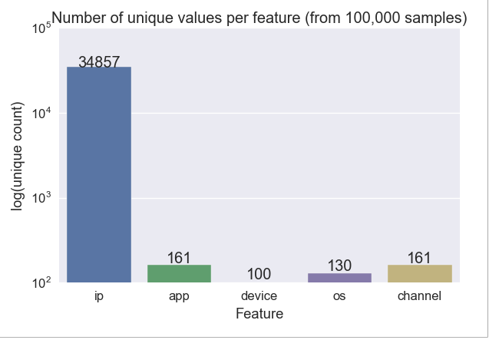
TalkingData AdTracking Fraud Detection

Slide 7
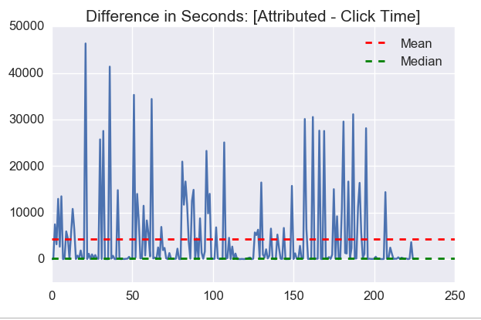
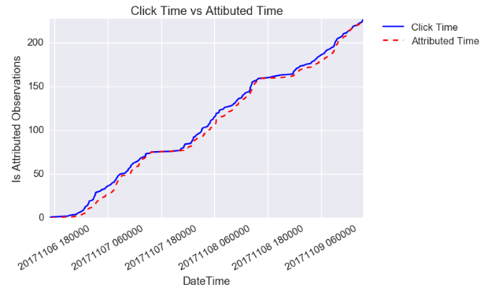
TalkingData AdTracking Fraud Detection
The [Attributed Time – Click Time] data in seconds shows the time between clicking on the app and the download time
The range of this is 2 sec to 46,341 (12.9 hours)

Slide 8
TalkingData AdTracking Fraud Detection
MODEL | DATA | ACCURACY | RECALL SCORE
Random Forest Classifier | Training Data – Test Split | 0.99788 | 0.04
Random Forest Classifier (After running the SMOTE algorithm) | Training Data – Test Split | 0.99712 | 0.2
XGBoost Classifier (After running the SMOTE algorithm) | Training Data – Test Split | 0.97584 | 0.74
Random Forest Classifier | Test Data | 0.9976
XGBoost Classifier | Test Data | 0.9929

Slide 9
TalkingData AdTracking Fraud Detection
Confidence Measurement | Max | Mean | Median | Min
ip_confRate | 6437 | 25.25 | 10.0 | 1
app_confRate | 141851 | 4672.9 | 12.0 | 1
device_confRate | 938053 | 3355.7 | 1.0 | 1
os_confRate | 239642 | 6250.0 | 38.0 | 1
channel_confRate | 92534 | 6493.51 | 1200.0 | 1
app_channel_confRate | 61413 | 1915.71 | 18.0 | 1
app_os_confRate | 34853 | 352.24 | 8.0 | 1
app_device_confRate | 134290 | 1342.28 | 2.0 | 1
channel_os_confRate | 22462 | 174.76 | 15.0 | 1
channel_device_confRate | 87519 | 1300.39 | 3.0 | 1
os_device_confRate | 233133 | 1721.17 | 3.0 | 1
Confidence Rate
1)some IPs, apps, devices, etc. might have higher frequencies of is_attributed.
2)conf_is_attributed=log(viewscategory_1)log(100000) where the value 100000 has been chosen arbitrarily to such that if a given category has 1000 views, then it gets a confidence weight of 60%, if it has 100 views then only a confidence weight of 40% etc

Slide 10
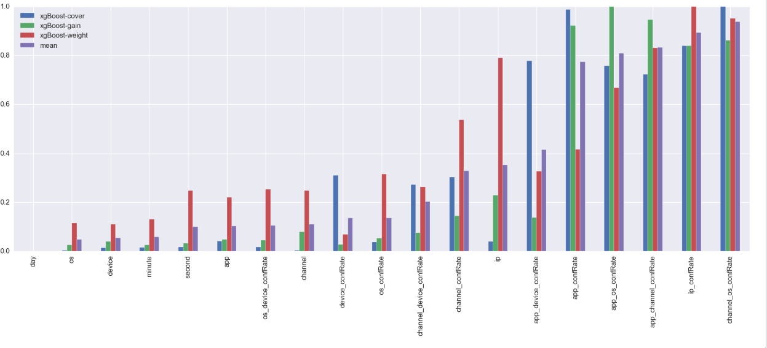
TalkingData AdTracking Fraud Detection
Feature Engineering & Feature Importance After running the XGBoost Classifier (Using Confidence Rate as an added metric)

Slide 11
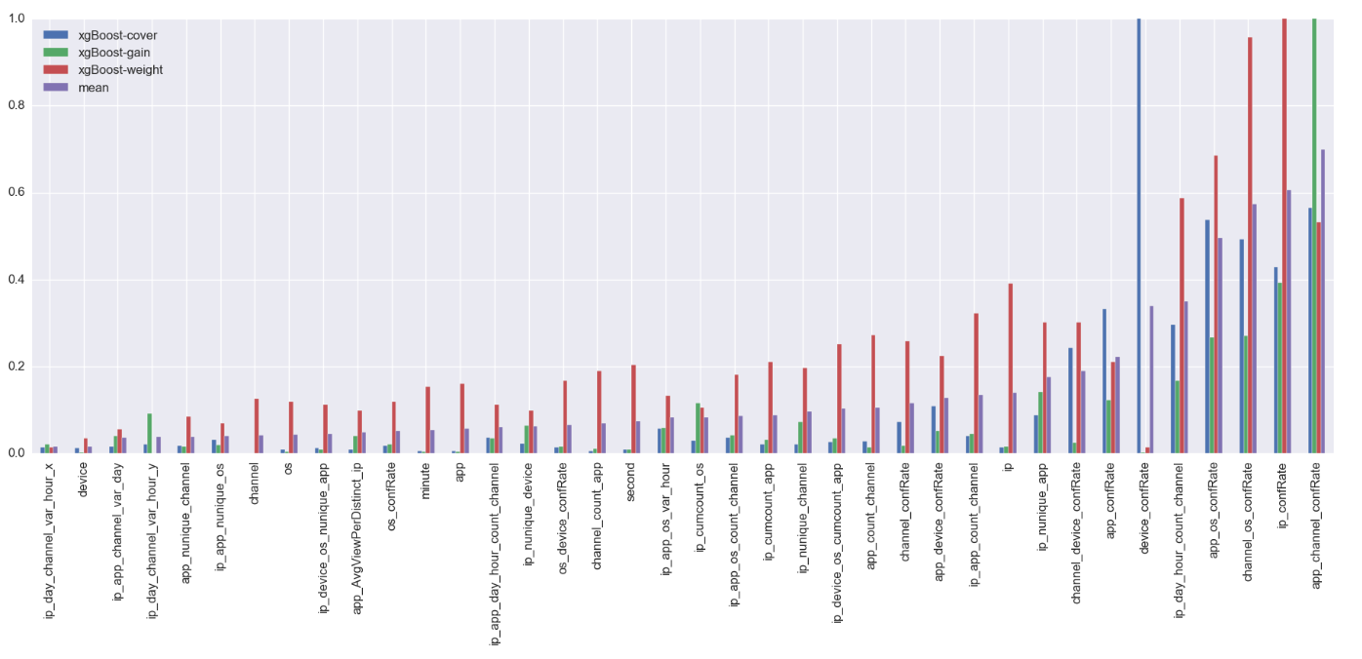
TalkingData AdTracking Fraud Detection
Apply all the groupby transformations, then XG Boost Classifier. The feature importances are MinMax scaled and then plotted ordered by the mean feature importance

Slide 12
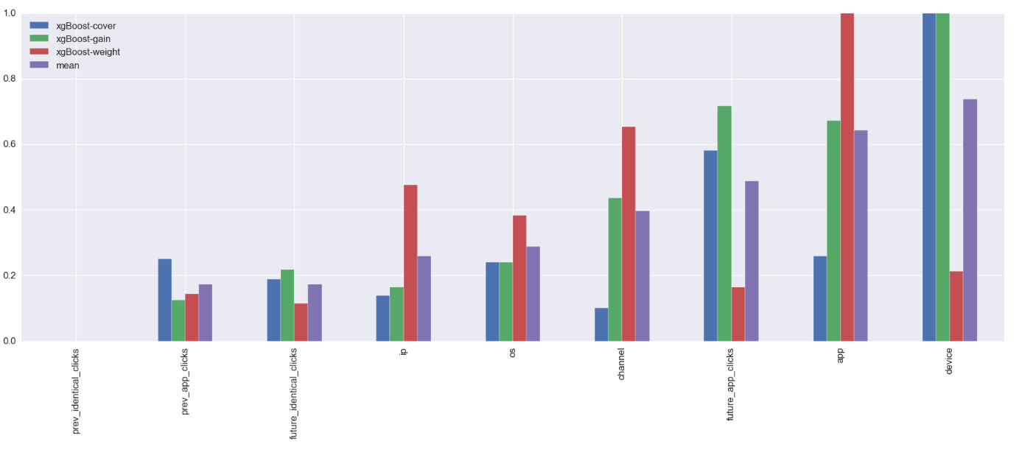
TalkingData AdTracking Fraud Detection
Feature Engineering – Using Previous and Future Clicks as metrics (Clicks on app ad before & after. Has the user previously or subsequently clicked with the exact same ip-app-device-os-channel)

Slide 13
TalkingData AdTracking Fraud Detection
SUMMARY OF OBSERVATIONS
CHANNEL-OS Confidence Rate -> Provides the greatest boost to the algorithm
APP-CHANNEL Confidence Rate -> Provides the greatest boost to the algorithm
DEVICE -> Most important feature contributing to the predictive analysis
When Click Time overlaps Attributed Time or is <= 10 secs, the sample can be considered ‘fraudulent’
Although the XGBoost Classifier adjusts the accuracy of the prediction, it takes care of overfitting the data which is an essential element in predictive analysis.

